Slide 1
Testing Autonomy: Hybrid Scenario Synthesis
by
Benjamin E. Hargis
ODU Dissertation: Spring 2025
https://www.linkedin.com/in/lulu-allen/
Presented by:
Lulu Allen
CS 800 - Research Methods
Assignment 6
April 15, 2026

Slide 2
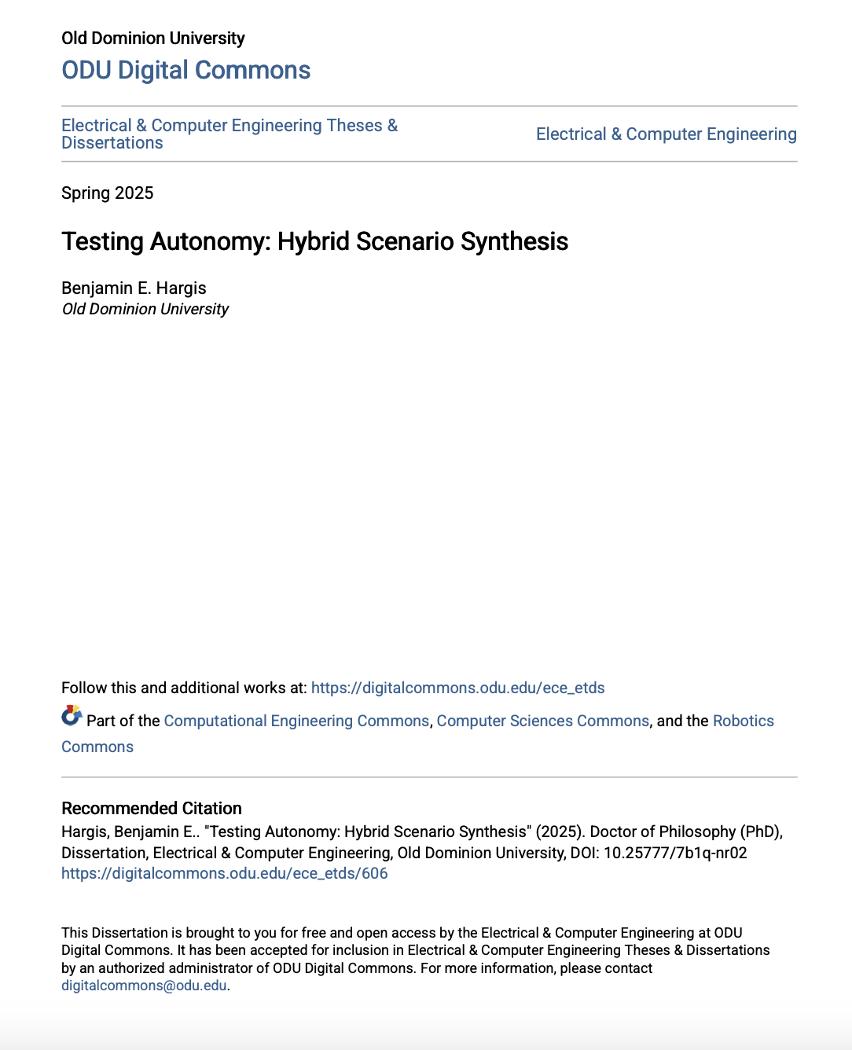
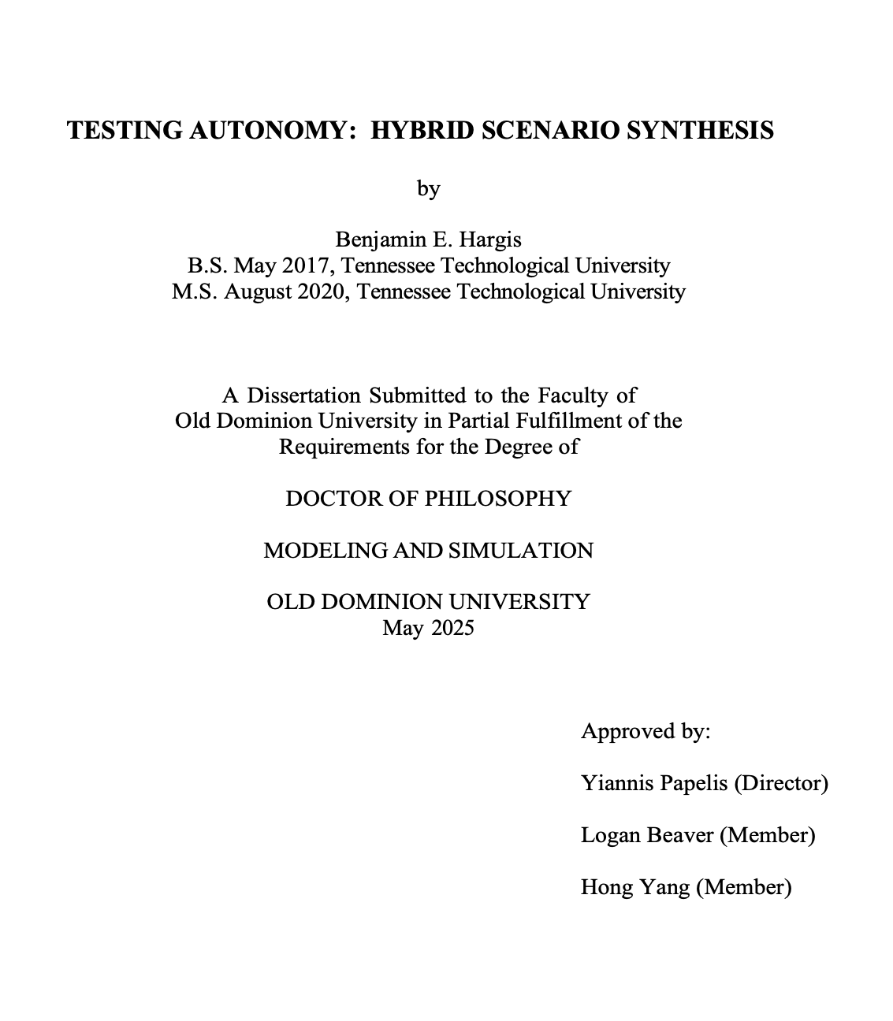
Paper Published
Dissertation

Slide 3
Motivation
Autonomous systems like ASV’s, UAVs, self-driving cars has increased in safety-critical domains
Static Simulation (single event) offer snapshot evaluations but miss evolving and has limited coverage in real-world dynamics
A key failure is the unpredictable SUT behavior can invalidate a designed test sequence mid-run
Parameterized at a single instant in time not over a duration which makes it hard to track intruders

Slide 4
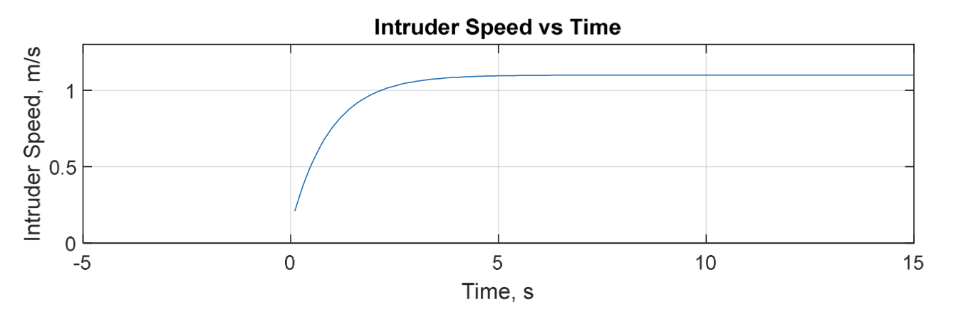
Intruder Trajectory
Fig 35. “Intruder Speed Over Time” https://digitalcommons.odu.edu/ece_etds/606

Slide 5
Related Work: Coverage-Based Testing
Tahir & Alexander (2022) - Adaptive sampling near performance transitions limited to highly controlled initial conditions affecting performance boundaries
Bolbot et al., (2022) Stanjiewicz & Mullins (2019) - Parameterize interactions at a single instant making tests vulnerable to SUT deviation
Key gap across all related work reveal no time horizon stimulus is not being sustained so if SUT deviates early, the designed test is invalidated

Slide 6
Research Questions
How can interaction stimuli be temporally parameterized to reflect the evolving complexity of autonomous encounters?
How can the difficulty of interactions be pre-quantified to filter trivial test cases?
How can a testing framework produce scenarios that are both static and adaptive to unpredictable system behaviors?
What practical challenges aise from sensor noise and kinematic limitations, and what strategies can be employed to address them?

Slide 7
RQ1
Interaction Model
Deterministic Interaction Synthesis Algorithm
Noise Mitigation
Avoidability Analysis
Interceptablilty Metric
How can interaction stimuli be temporally parameterized to reflect the evolving complexity of autonomous encounters?

Slide 8
Interaction Model Design
The core of the work define by a six-parameter, time-dependent interaction model
DDCPA (Desired Distance to Closest Point of Approach): the minimum spatial separation between the SUT and an intruder vessel
Desired Start Time: beginning of interaction timeline
Desired Event Time: bounding the interaction timeline
SUT State: position, heading, and speed retrieved in real-time from the simulation
Relative Intruder Speed: respect to the SUT frame
Heading Difference: angular offset between SUT and intruder trajectories

Slide 9
Deterministic Interaction Synthesis Algorithm
The principles of relative motion and affine coordinate transformation define by three phrases
Orchestration Phase (before start)
Calculates the intruder’s path in the SUT’s frame based on the tangent circle at DCPA
1
Implementation Phase (start to event)
Transforms the path into world coordinates using the current SUT state
2
Post-Event Phase (after event)
The intruder keeps its heading and speed or returns to normal traffic
Fig 1. Dissertation Review by Lulu Allen
3

Slide 10
Noise Analysis
Problem:
Sensor noise causes small heading oscillations in the SUT, leading to erratic intruder trajectory deviations, especially at short ranges
Mitigation:
Apply a windowed running average of the SUT heading using vector-component averaging to handle circular heading values.
Trade-off:
Larger windows better smooth noise but delay the system's response to real SUT heading changes

Slide 11
RQ2
Avoidability: Uses a formula to check if the SUT can avoid the intruder before running the scenario, flagging impossible cases early.
Interceptability: Gives a score from 0 to 1 showing how easy it is for the intruder to intercept, so simple tests can be skipped.
How can the difficulty of interactions be pre-quantified to filter trivial test cases?

Slide 12
Avoidability Analysis
Determines if a kinematically reachable path ensures sufficient separation from the intruder
If intruder’s position is outside of SUT’s reachable path, avoidance is guarantee
Derives numerical and analytic solutions for the kinematic envelope based on yaw rate, speed, and time horizon
Finds that the angular boundary of the kinematic envelope is defined by the analytic solution

Slide 13
Interceptablilty Metric
Intent Probability Map
Propagate velocity and yaw uncertainty via odometer error model
SUT Kinematic Path
Map all positions reachable by SUT within time horizon
04
01
03
Uniform Probablility Model
Assign equal probability across SUT reachable area
Interceptability Score
Sum probabilities within intruder’s reachable region [0,1]
02
Fig 2. Dissertation Review by Lulu Allen

Slide 14
RQ3
Static Testing fails when autonomous system deviates from predicted path
Adaptive Testing dynamically adjust to SUT behavior but is harder to design deterministically
Pursuit Percent reveal a window which the intruder actively follows the trajectory plan. After expiration, the intruder maintains current heading and speed
100%: encounter is unavoidable
Lower values (i.e., 70%): the SUT can potentially maneuver to safet allowing better performance assessment
How can a testing framework produce scenarios that are both static and adaptive to unpredictable system behaviors?

Slide 15
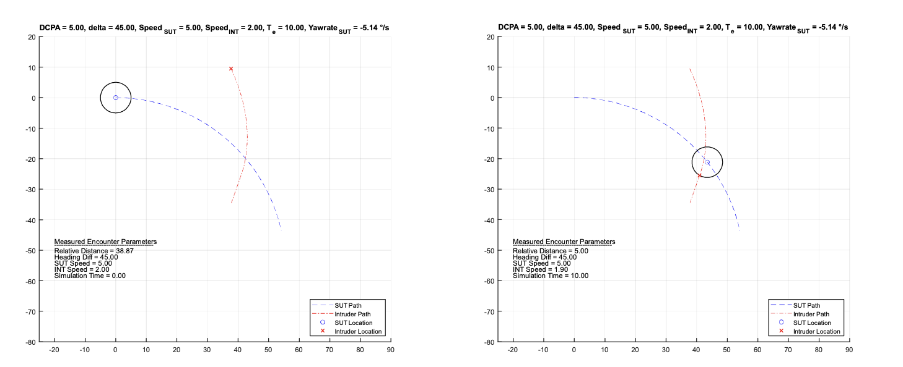
Pursuit Percent
Fig 15. “Pursuit Percent Example” [1.0] https://digitalcommons.odu.edu/ece_etds/606

Slide 16
Evaluation Process
Trajectory (MATLAB): Ran two cases with Euler integration = 0.1s. Constant velocity and heading achieved DCPA of -5.00m at 10s. A 180° heading change can still achieved DCPA confirming robustness.
Monte Carlo: Tested 500 randomized SUT behaviors; errors remained around 10⁻¹⁵, confirming high deterministic accuracy.
VMATE Deployment: Successfully tested in VMATE with a clean crossover and a noisy trajectory; the noisy case matched predicted erratic behaviors, validating noise analysis.

Slide 17
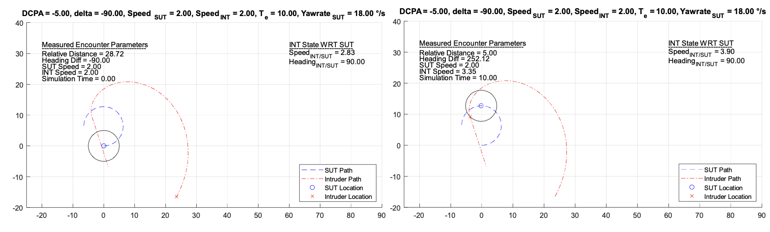
MATLAB Validation
Fig 8. “Constant Velocity & 180 Heading Change Event at Start Time (Left) & Event Time (Right)

Slide 18
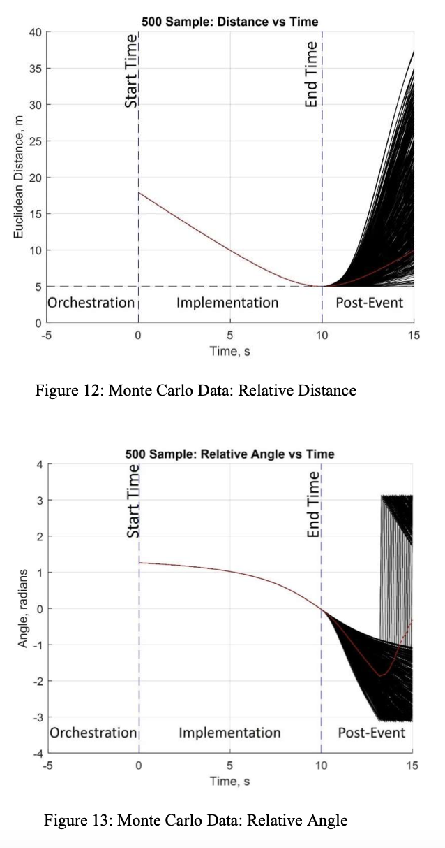
Monte Carlo Validation
https://digitalcommons.odu.edu/ece_etds/606

Slide 19
RQ4
Gaussian heading noise leads to erratic, compounding errors in intruder trajectory
In the US Navy’s ASTC/VMATE environment, behavior tree integration, real-time tracking, and encounter triggers showed the predicted erratic behavior, confirming the noise analysis
What practical challenges arise from sensor noise and kinematic limitations, and what strategies address them?

Slide 20
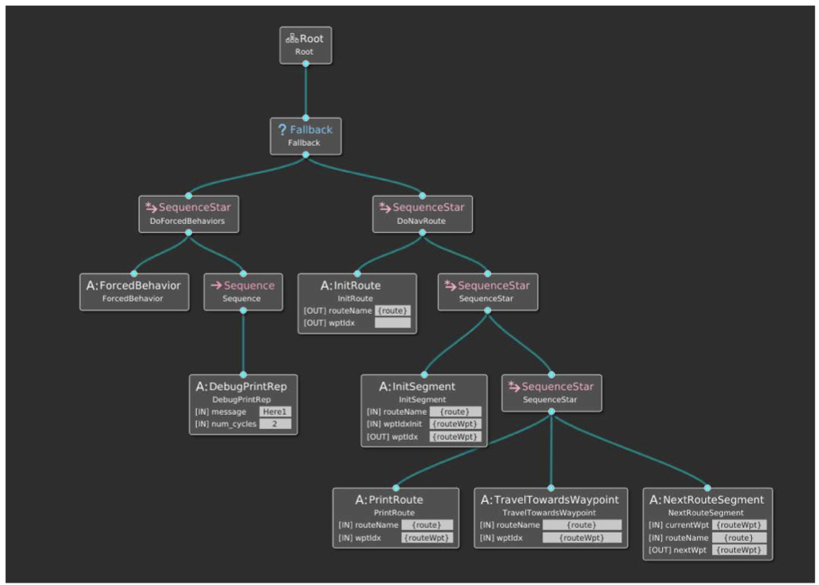
VMATE Behavior Tree
Fig 39. “Traffic Behavior Tree” https://digitalcommons.odu.edu/ece_etds/606

Slide 21
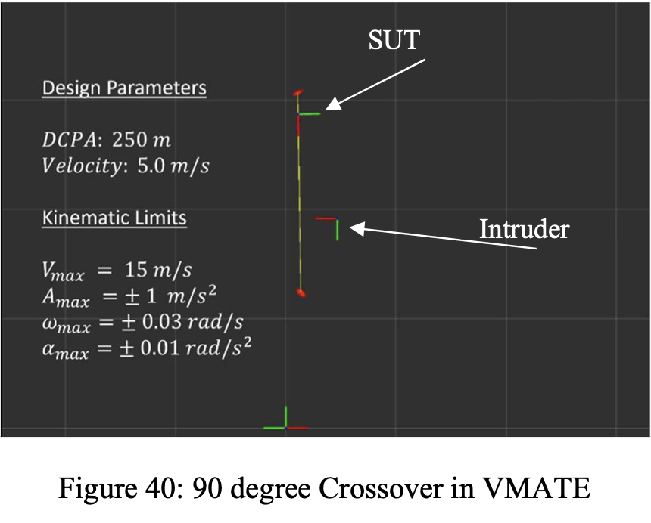
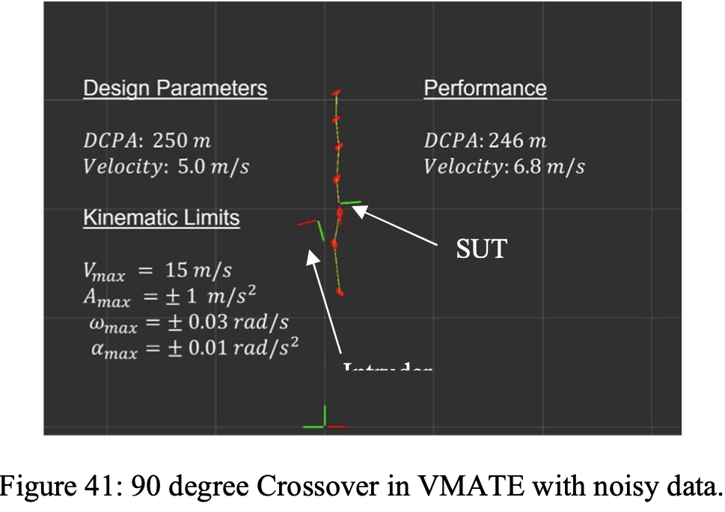
VMATE High-Fidelity Deployment
https://digitalcommons.odu.edu/ece_etds/606

Slide 22
Results
MATLAB
Intruder trajectory held exactly as designed during constant & 180 degree heading SUT with DCPA =-5.00m achieved & Desired Event Time = 10.0s
Pass
Monte Carlo
All 500 runs achieved designed DCPA within numerical precision during implementation phase
100%
VMATE High-Fidelity Deployment
At 90 degrees the crossover test executed as designed and validated end-to-end pipeline
90
Fig 3. Dissertation Review by Lulu Allen

Slide 23
References
Hargis, Benjamin E.. "Testing Autonomy: Hybrid Scenario Synthesis" (2025). Doctor of Philosophy (PhD), Dissertation, Electrical & Computer Engineering, Old Dominion University, DOI: 10.25777/7b1q-nr02 https://digitalcommons.odu.edu/ece_etds/606
Araujo, Hugo, Mohammad Reza Mousavi, and Mahsa Varshosaz. (2023). Testing, Validation, and Verification of Robotic and Autonomous Systems: A Systematic Review. ACM Transactions on Software Engineering and Methodology 32(2): 1–61. doi:10.1145/3542945.
Biggar, Oliver, Mohammad Zamani, and Iman Shames. (2021). A Principled Analysis of Behavior Trees and Their Generalisations. doi:10.48550/arXiv.2008.11906
Hargis, Benjamin E, and Yiannis E Papelis. (2022a). Simulation-Based Approach to Synthesizing Maritime Interaction Scenarios for Testing Autonomy. I/ITSEC 2022 Conference.
Hargis, Benjamin E, and Yiannis E Papelis. (2023). Statistical Approach to Quantifying Interceptability of Interaction Scenarios for Testing Autonomous Surface Vessels. https://digitalcommons.odu.edu/cgi/viewcontent.cgi?article=1037&context=msvcapstone.

